Slide 1
Gas vs. Coal in the UK
Fuel switching in the united kingdom power sector
Hu, xi 13 may 2018

Slide 2
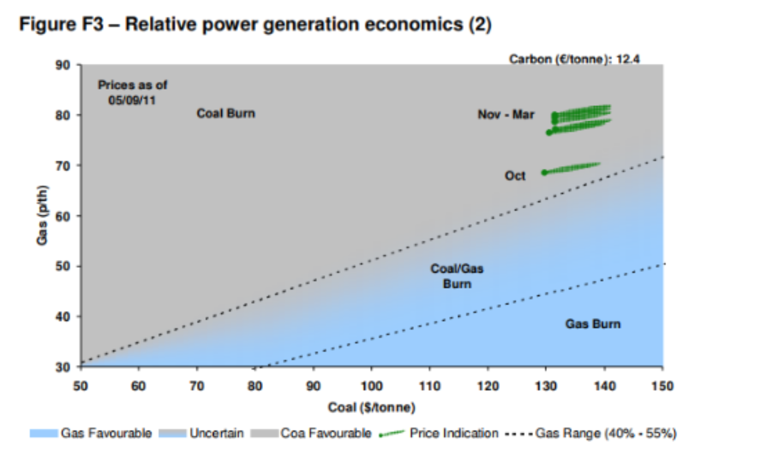
Fuel Switching
Definition: Do power stations in the UK decide to consume Gas or Coal to generate electricity.
Example, date as of 5 Sep 2011
Currently (Sep 2011), Figure F3 concludes that the market strongly favors coal over gas
There is a significant coal plant advantages over gas. In winter of 2011, gas price will have to decrease 33% to be equitable as coal.

Slide 3
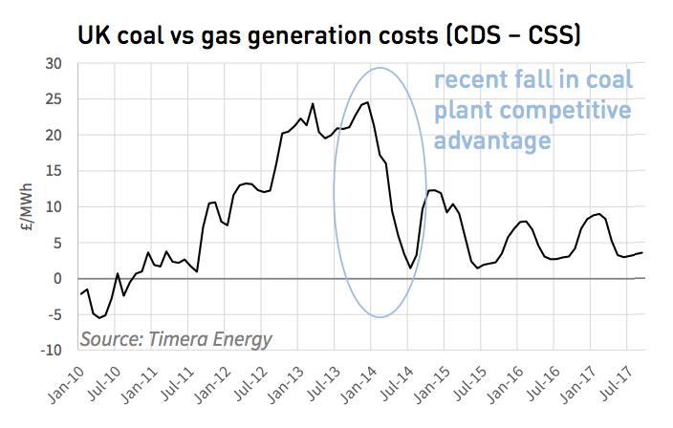
Gas Plant Competitiveness
Gas price slump: Going forward 2013, growing oversupply of LNG leads to a weaker oil price. Coal plant competitive advantages are taken off, fuel switching is then seen towards gas.
Switching markets in Europe: More than 70% of European switching potential is focused on 5 top markets – UK, Italy, Spain, Germany and Netherlands. Lower gas prices could reduce the gap in gas vs. coal plant competitiveness. Gas-based power plants could thus absorb the margin leading to a higher load factor.
UK took the first move, then continental gas plants could finally increase the “in the moneyness” due to the decrease of gas price fall.

Slide 4
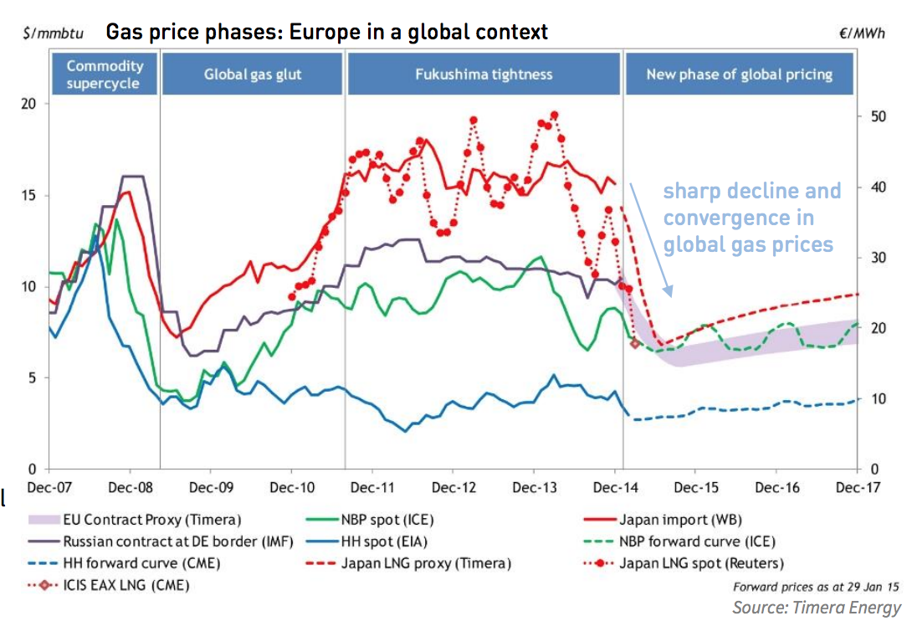
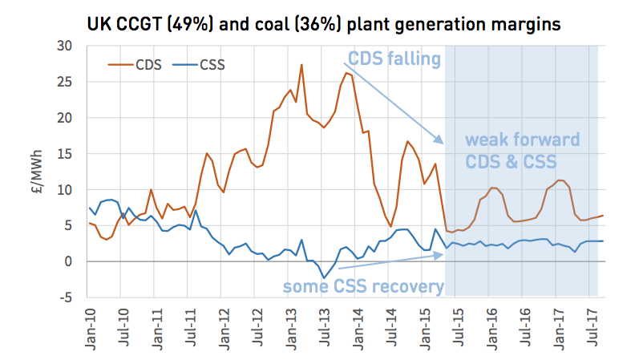
Gas vs. Coal Switching in UK

Slide 5
Gas vs. Coal Switching in UK
2014– 2015 gas price dynamics: Slump in Asian LNG spot prices, sharp drop in oil-index contract prices, flexible LNG flowing back into European hubs as a market of last resort, and regional price convergence
European hubs (NBP/TTF) are currently acting as global gas price support. Hub prices might fall further, to a level where power sector gas demand provides support.
With these information, we could conclude that fuel switching happens because of the costs to generate electricity. If global coal supply increases, then coal becomes cheaper, and fuel switching towards coal, and vice versus.

Slide 6
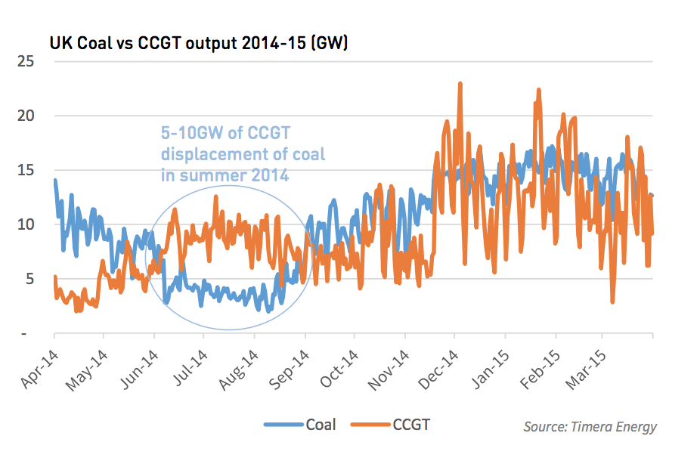
Fuel Switching in UK 2014
As discussed above, we have the electricity output in the year of 2014 – 2015. In 2014, global oversupply of LNG leads to the 5-10 GW of CCGT displacement of coal in summer 2014.
The fuel switching of gas vs coal in act could contribute to alleviating the downward pressure on European hub prices.

Slide 7
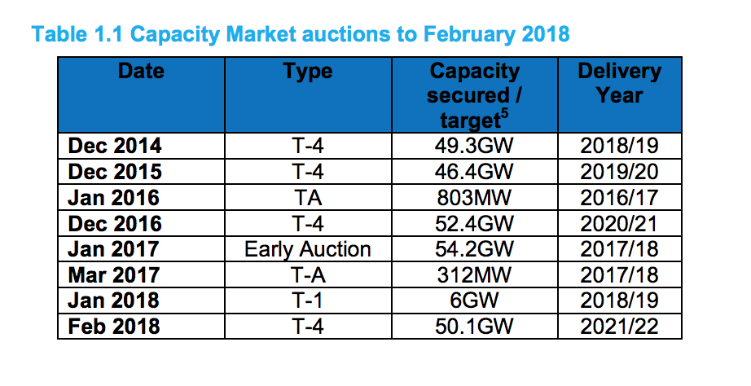
UK’s total gas demand in winter 2017/18
Statutory security of supply report 2017 of Department for Business, Energy & industrial Strategy includes:

Slide 8
Credit
1. https://www.timera-energy.com/content/uploads/2015/03/Timera-gas-v-coal-switching-190515.pdf
2. https://www.nationalgrid.com/uk/gas/market-operations-and-data/transmission-operational-data
3. https://www.timera-energy.com/gas-vs-coal-switching-in-europe-key-markets/
4. https://www.gov.uk/government/collections/gas-statistics
5. https://assets.publishing.service.gov.uk/government/uploads/system/uploads/attachment_data/file/663894/hc536-statutory-security-of-supply-report-2017.pdf
6. https://www.bloomberg.com/news/articles/2018-05-02/chilly-britain-absorbing-more-gas-that-would-have-gone-to-europe

Slide 9
Further Exploration
To research on UK’s total gas demand in the winter of 2017/2018, I planned to start with:
Historical total gas demand, e.g., in the winter of 2016/2017
Check global supply of gas, and pay close attention on fuel switching.
Examine forecasted total demand of electricity, e.g., winter of 2017/2018 becomes surprisingly cold and more electricity is thus required.

